Slide 1
Fact or Fiction
Data Mining Exploration of the LIAR Dataset
Ankuran Chattoraj

Slide 2
Objective
Fake news is a type of false or misleading information that is deliberately spread through traditional or social media platforms.
The spread of fake news has become a major problem in recent years
Fake news can have serious consequences. Ex: It can affect public opinion
Therefore, detecting and combating fake news has become a priority for many individuals, organizations, and governments around the world
The goal of this project is to develop a model that can accurately classify the veracity of political statements using the LIAR dataset. Specifically, the model will predict whether a statement is true or false

Slide 3
Data Description
The fake news dataset was obtained from Kaggle, A subsidiary of Google. Kaggle allows users to find datasets they want to use in building AI models to solve data science challenges
The dataset consists three separate datasets for training, testing and validation
The training dataset consists a total of 10269 records and 14 variables
The testing dataset consists a total of 1283 rows and 14 columns
The validation dataset consists a total of 1284 rows and 14 columns

Slide 4
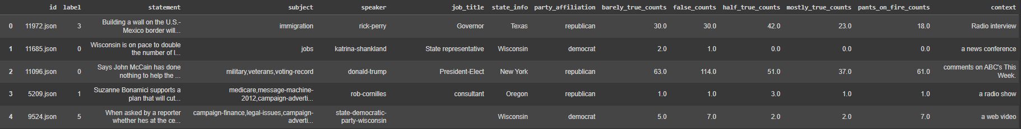
Dataset

Slide 5
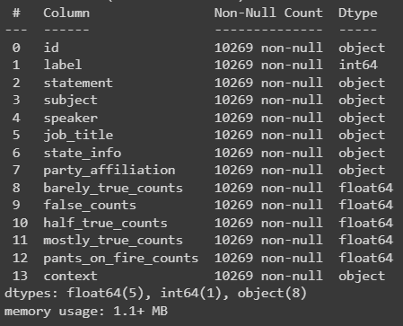
Variable Description

Slide 6
Variable Description
id | Unique identification for the record
label | Label denoting whether record is true or false
statement | Statement by the speaker
subject | Subject of what the statement is about
speaker | Name of the speaker
job_title | Job title of speaker
state_info | State of the speaker
party_affiliation | Political affiliation of the speaker
barely_true_counts | Numeric
false_counts | Numeric
half _true_counts | Numeric
mostly_true_counts | Numeric
pants_on_fire_counts | Numeric
context | Medium of the statement

Slide 7
Data Cleaning and Preprocessing
Firstly, we convert all the blank entries in the dataset into null values
There are null values present in the job_title, state_info and context variables. So we are dropping all the records where these three columns are null
The numeric entries of the label column are replaced to their dedicated ordinal categories
Next we correct the state names in the state_info column so that one state name has the same string if it repeats in the variable
We also strip the blank spaces present for every entry and capitalize so that the entries are uniform and follow the same casing throughout the dataset

Slide 8
Data Cleaning and Preprocessing
Tokenization is the process of breaking text into smaller units, called tokens, which are typically words or individual characters. Word-based tokenization involves separating text into tokens based on word boundaries, using techniques such as regular expressions or specific NLP libraries
The TF-IDF vectorizer is being used to solve this purpose
The concept of Binary Classification is used to classify whether the statements are true or false
True, Mostly True, Half true are classified as true and pants on fire, barely true and false counts are classified as false

Slide 9
Data Exploration
The initial exploration of the data involves analyzing the distribution of the two labels and checking for any class imbalance. Next, examining the length of the articles, the number of words per sentence, and the most frequent words and phrases used in each label. This can provide insights into the writing style and content of the articles, which may be indicative of their authenticity.
Additionally, we use visualization techniques to identify any clustering or grouping of articles based on certain features, such as the source or the topic. This can help in identifying any patterns or relationships between the features and the labels.
Furthermore, we apply machine learning algorithms to the data, such as classification models or clustering algorithms, to explore the performance of various approaches in identifying fake news. This involves splitting the data into training and testing sets, evaluating the models' accuracy, and tuning their hyperparameters to improve performance.

Slide 10
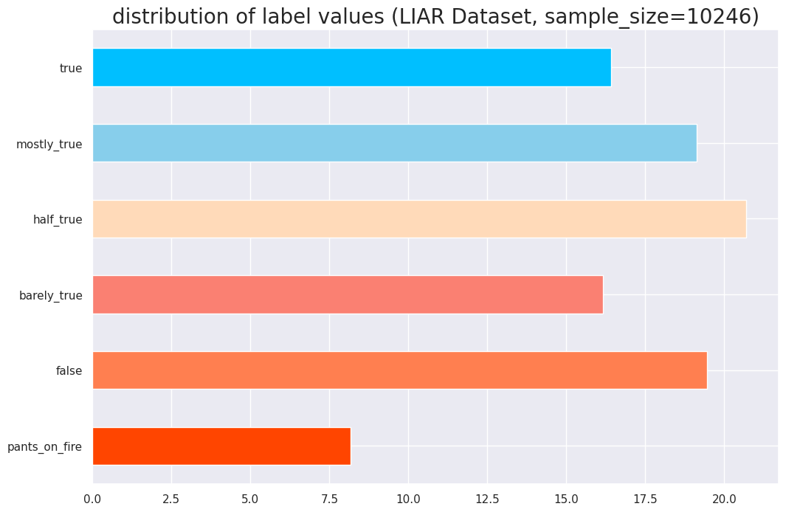
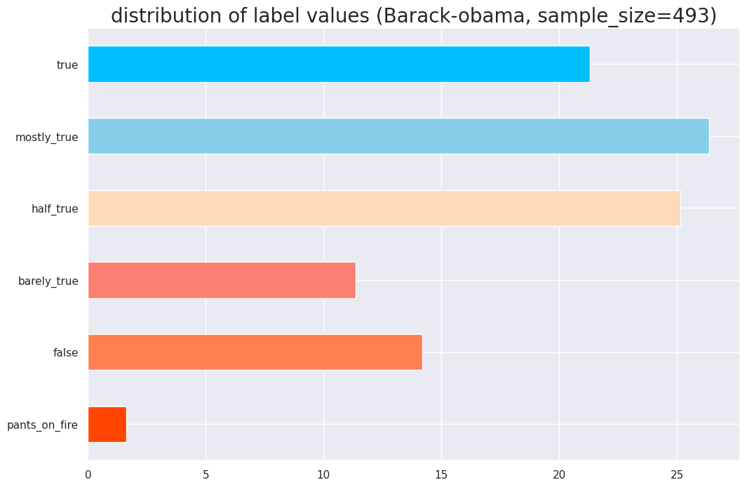
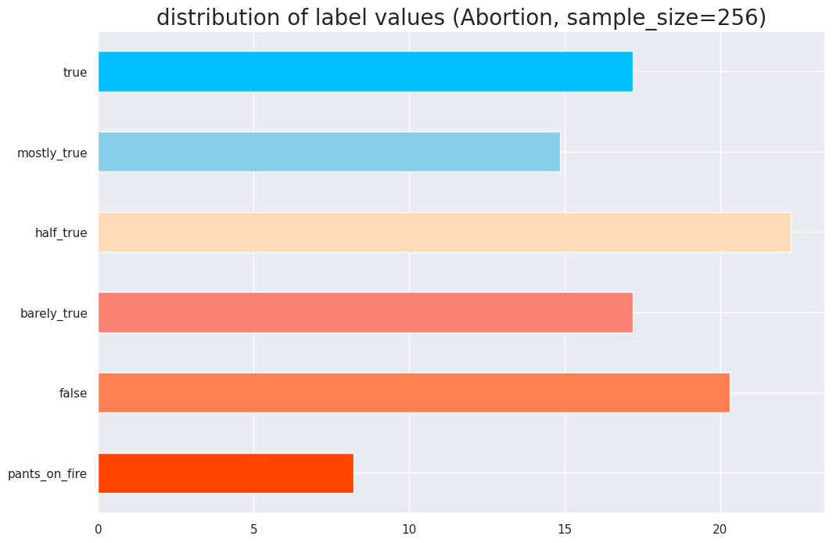
Exploratory Data Analysis

Slide 11
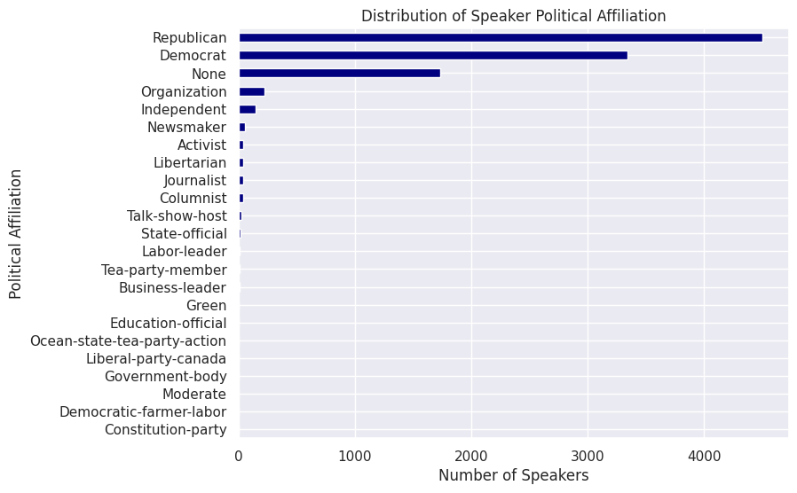
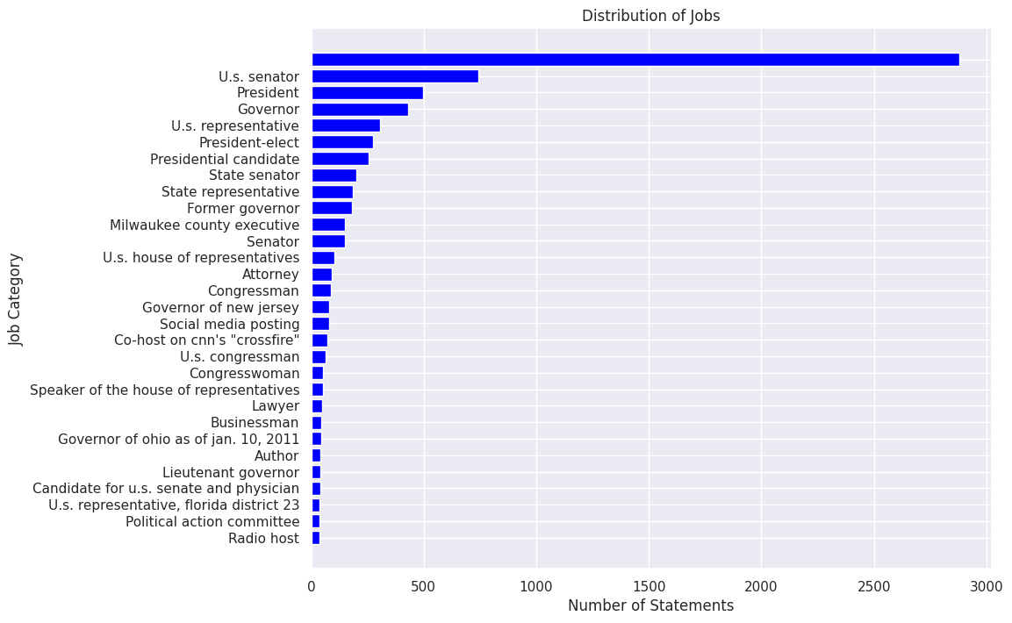
Distribution of Speaker’s Political Affiliation and Jobs

Slide 12
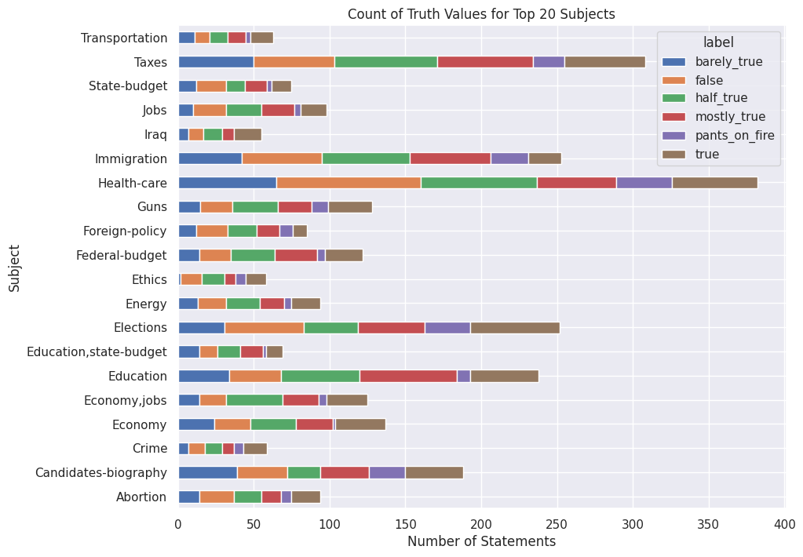
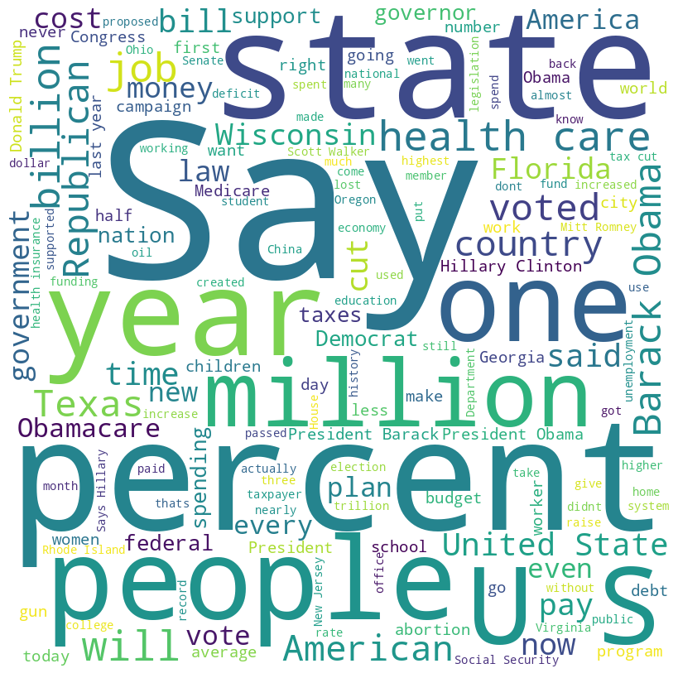
Stacked Bar Chart and Word Cloud

Slide 13
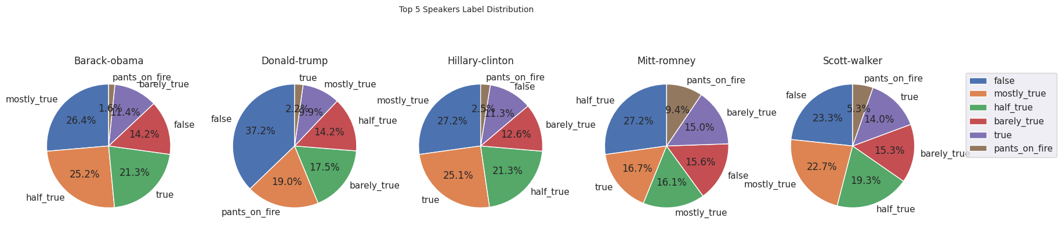
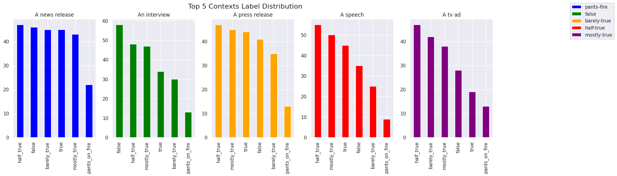
Pie plots and Bar chart

Slide 14
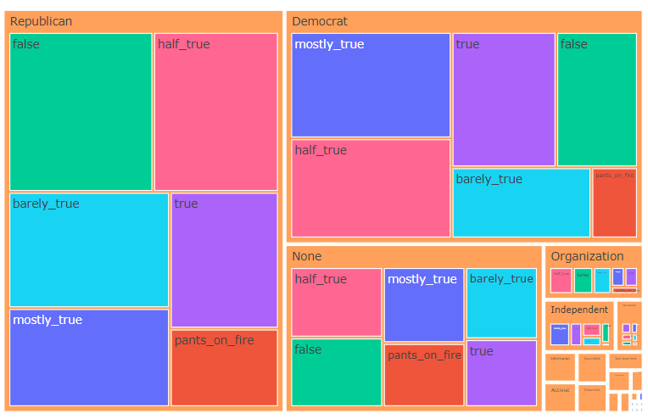
Treemap

Slide 15
Data Mining Model
We have three datasets separately for training, testing and validation which consist of 10269, 1283 and 1284 records respectively
The following models are used for classification:
Logistic Regression
Naive Bayes
Support Vector Machines
Random Forest Classifier
Voting Classifier

Slide 16
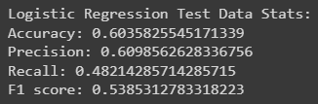
Logistic Regression Model
Logistic regression model was evaluated on a fake news dataset
Model performance was measured using accuracy, precision, recall, and F1 score
Accuracy was 60.3%, indicating the percentage of correctly classified instances of fake news
Precision was 60.9%, indicating the ability of the model to correctly classify instances of fake news
Recall was 48.2%, indicating the ability of the model to detect all instances of fake news
F1 score, which is the harmonic mean of precision and recall, was around 54%

Slide 17
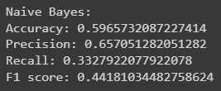
Naive bayes Model
Naive Bayes model was evaluated on a fake news dataset
Model performance was measured using accuracy, precision, recall, and F1 score
The performance metrics can be observed on the right
The Naive Bayes model performed poorly giving the least F1 score compared to all the models used in this project

Slide 18
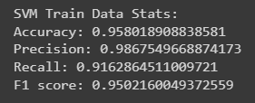
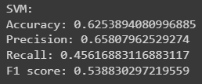
Support Vector Machines
Support Vector Machines model was evaluated on a fake news dataset
Performance evaluation of SVM on the fake news dataset involves using metrics such as accuracy, precision, recall, and F1 score
SVM finds the best separating hyperplane between the two classes of data
The effectiveness of SVM in classifying fake news can be measured by its ability to correctly classify true positives and true negatives while minimizing false positives and false negatives
By observing the metrics we can say that the model is an overfitting model

Slide 19
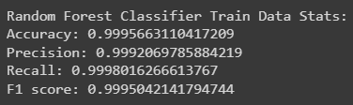
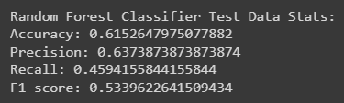
Random Forest Model
Random Forest model was evaluated on the fake news dataset
The model performs better than the SVM model slightly
By observing the performance metrics of the training and testing data we can say that the model is overfitting the data
The concept of hyperparameter tuning on Random Forest classifier gave the best performance metrics compared to the other models used in this project
Hence, the Random Forest model has been chosen as the best performing model

Slide 20

Voting Classifier
Voting classifier is an ensemble machine learning model that combines multiple algorithms to improve the overall performance
It can be used for both classification and regression tasks.
In this project, we used a voting classifier that combined logistic regression, decision tree, and SVM models to classify the LIAR dataset

Slide 21

Hyperparmeter Tuning of Random Forest using Grid Search CV
Hyperparameter tuning is an important step in machine learning to improve the performance of models
Random forest is a popular ensemble learning method that can improve the accuracy of predictions
In this project, we used grid search CV to find the optimal hyperparameters for the random forest model, which include the number of trees in the forest, the maximum depth of the trees, and the minimum number of samples required to split a node
The optimized hyperparameters were used to train the random forest model and achieved a higher accuracy compared to the default hyperparameters

Slide 22
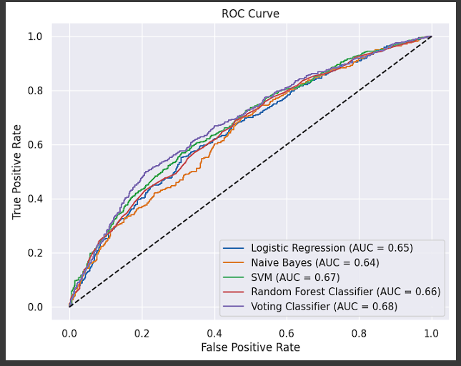
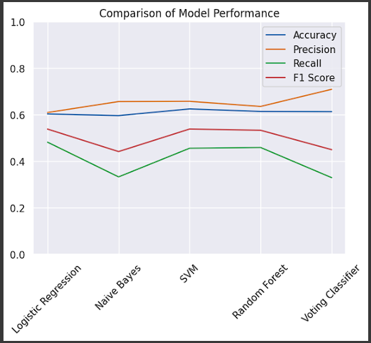
Performance Evaluation Visualizations

Slide 23
Thank you

Slide 24
Try & Fail.
But don’t Fail to Try.

